Slide 1
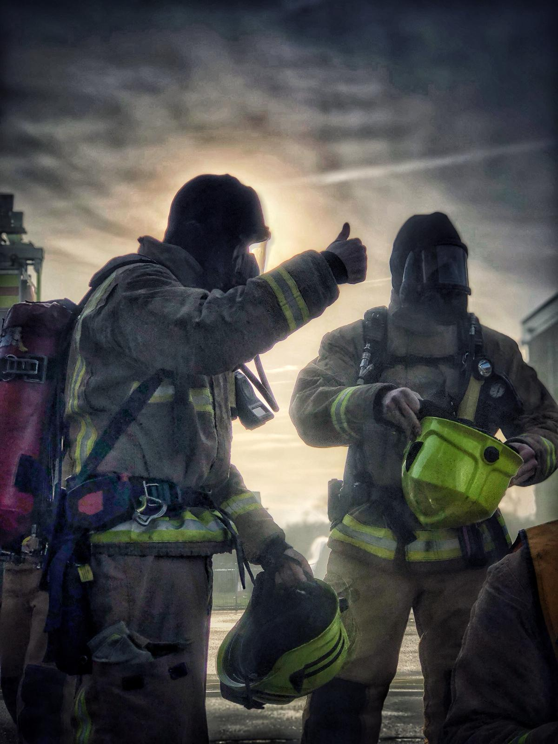
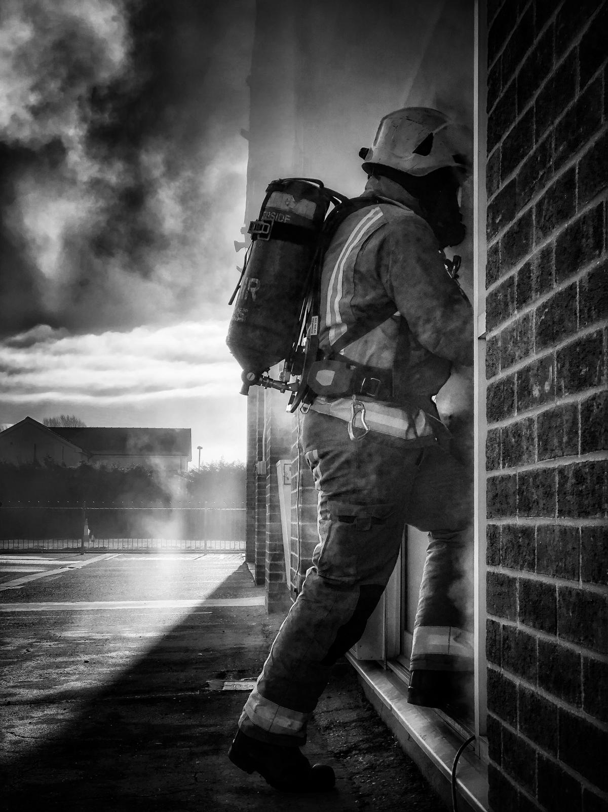
Humberside Fire & Rescue Service
Bonfire & Firework Safety - L1
Working in partnership to help to keep you safe
Notes:
We’re here to tell you how to keep yourself, your friends and families safe on Halloween & bonfire night.
Today is to give you some advice on how to have a safe, enjoyable bonfire night and prevent injuries.
We will also look at the consequences of not following the advice.

Slide 2
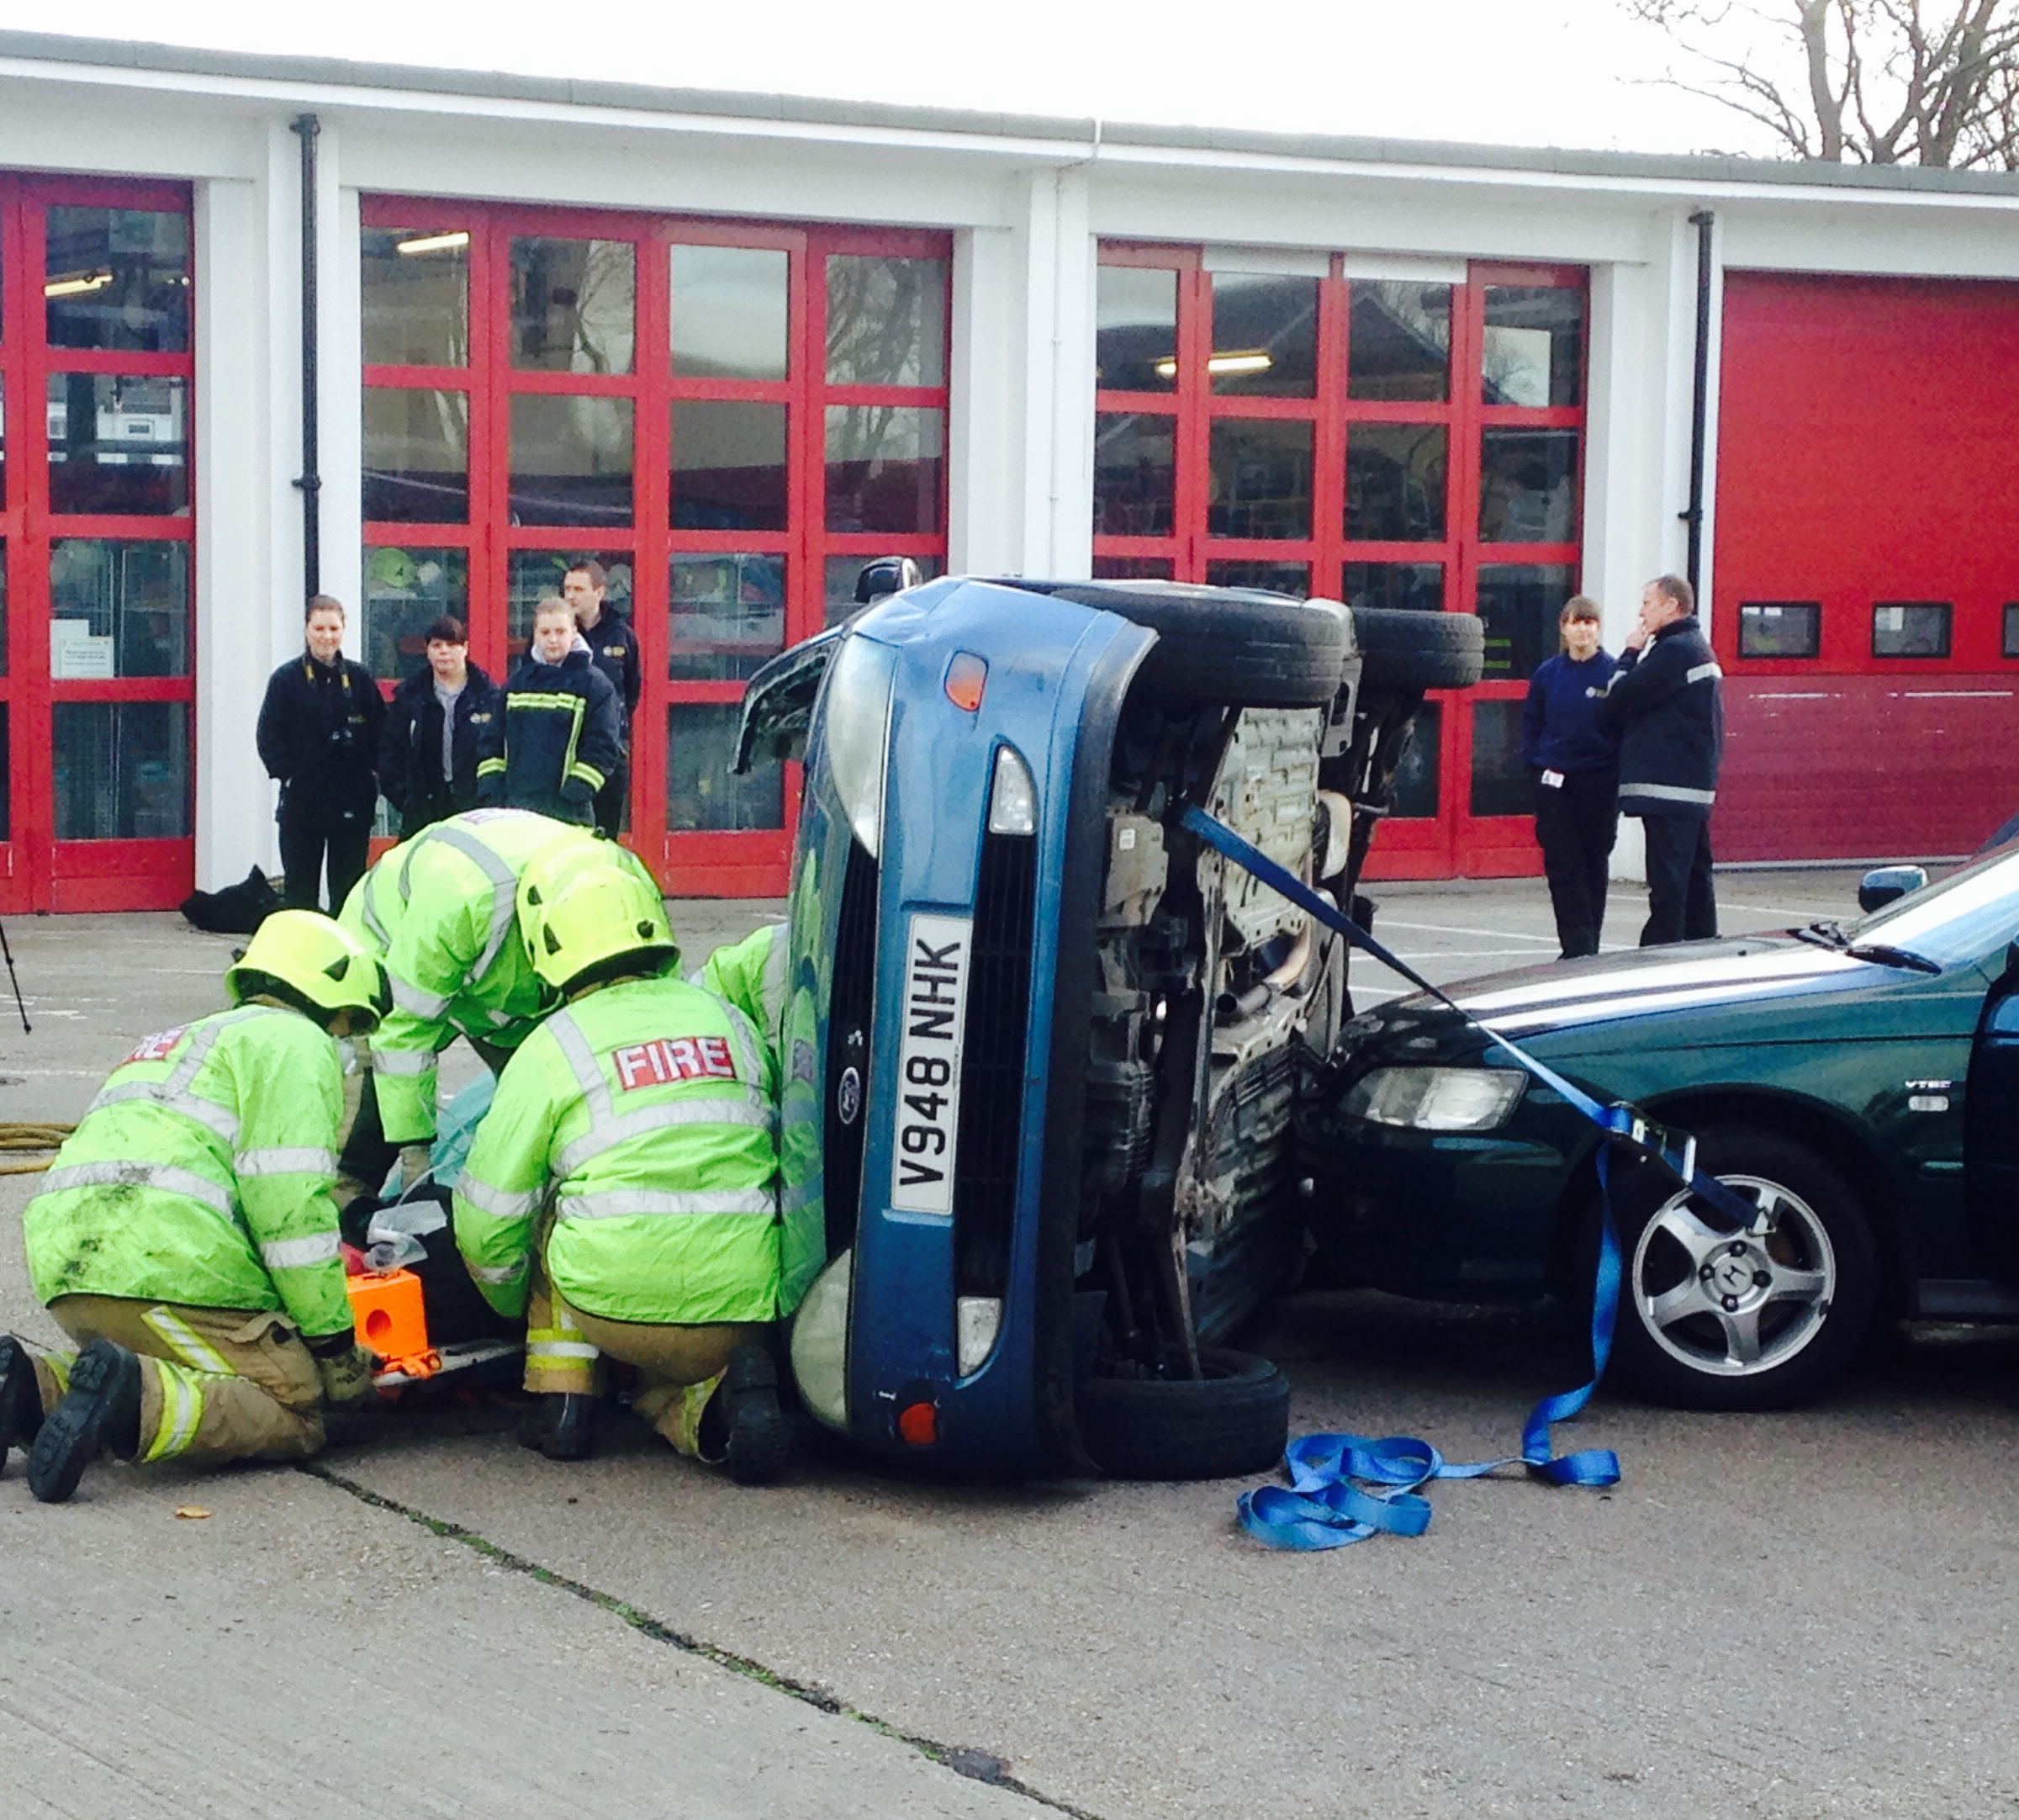
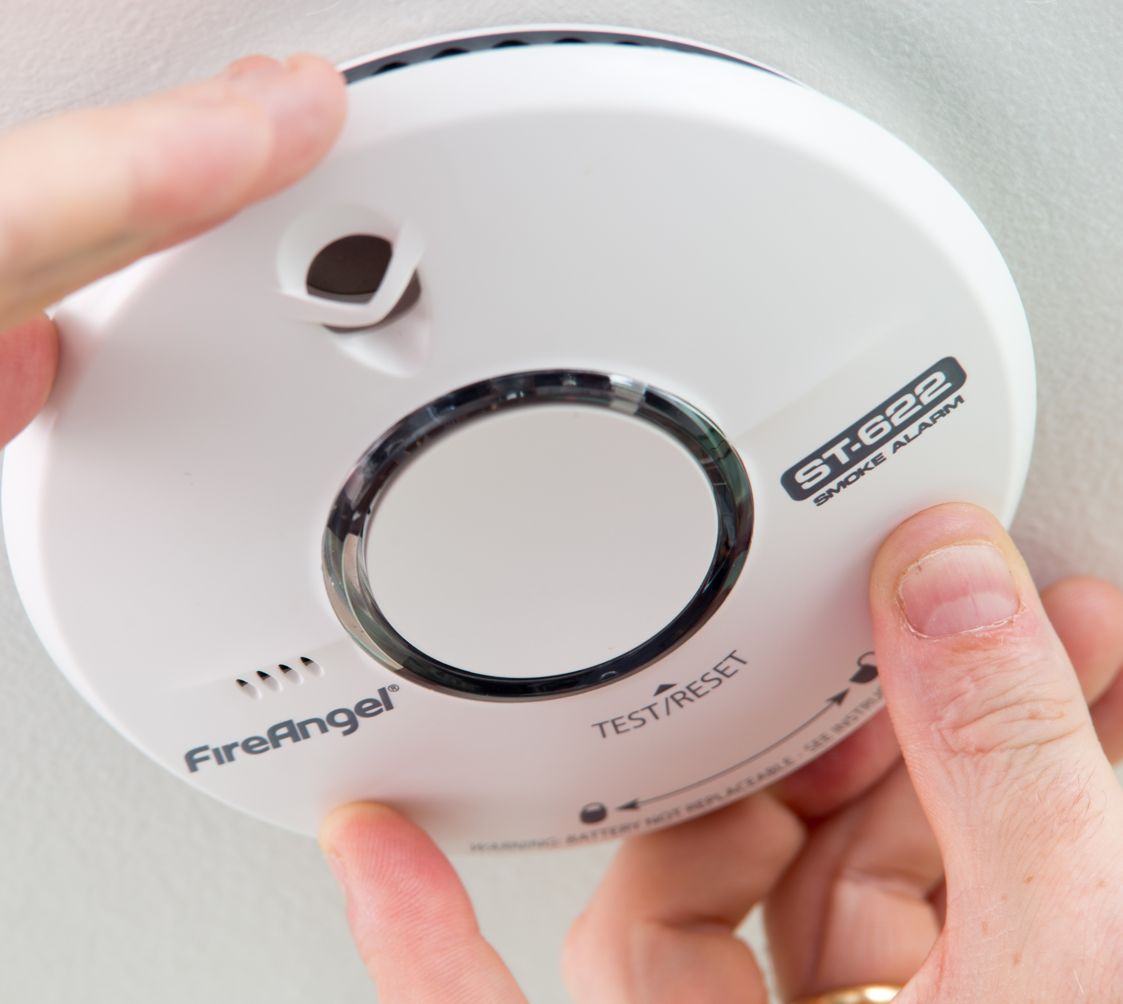
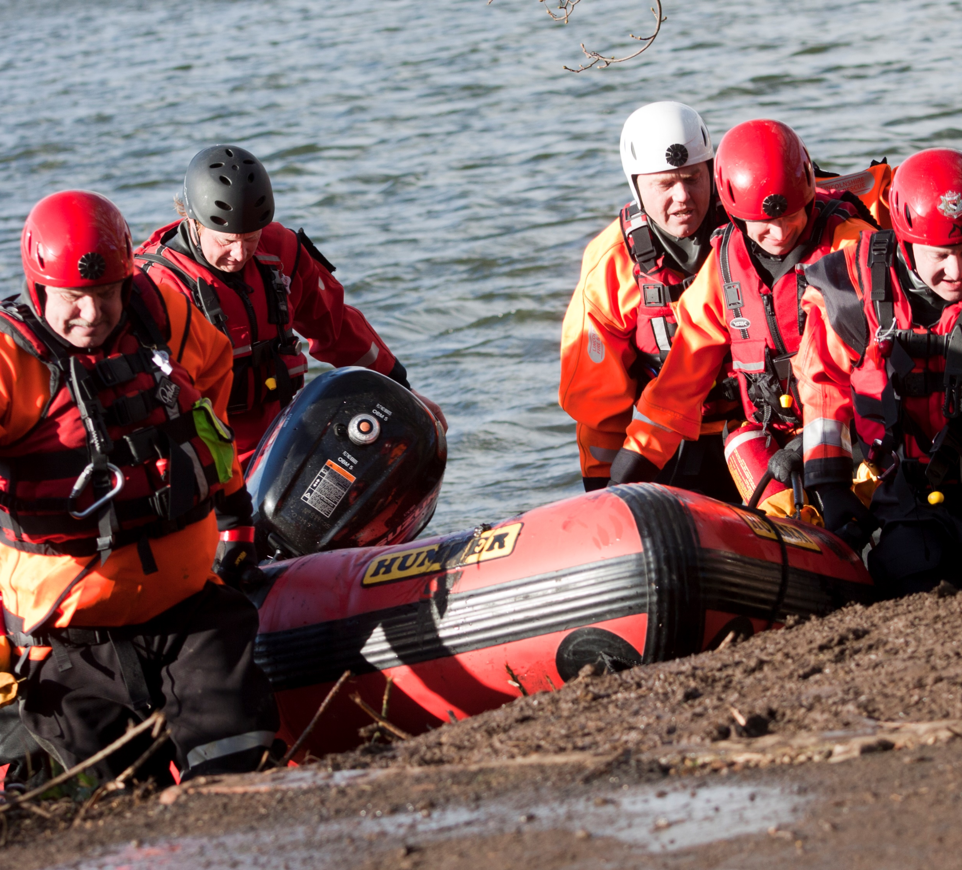
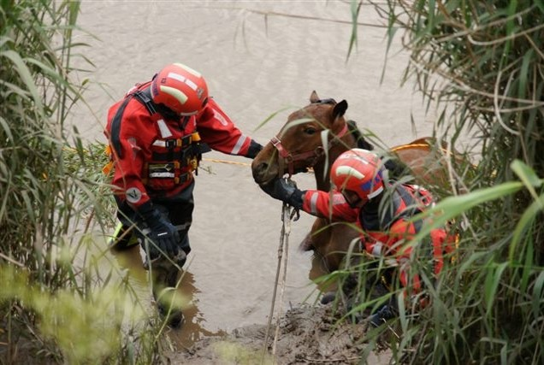
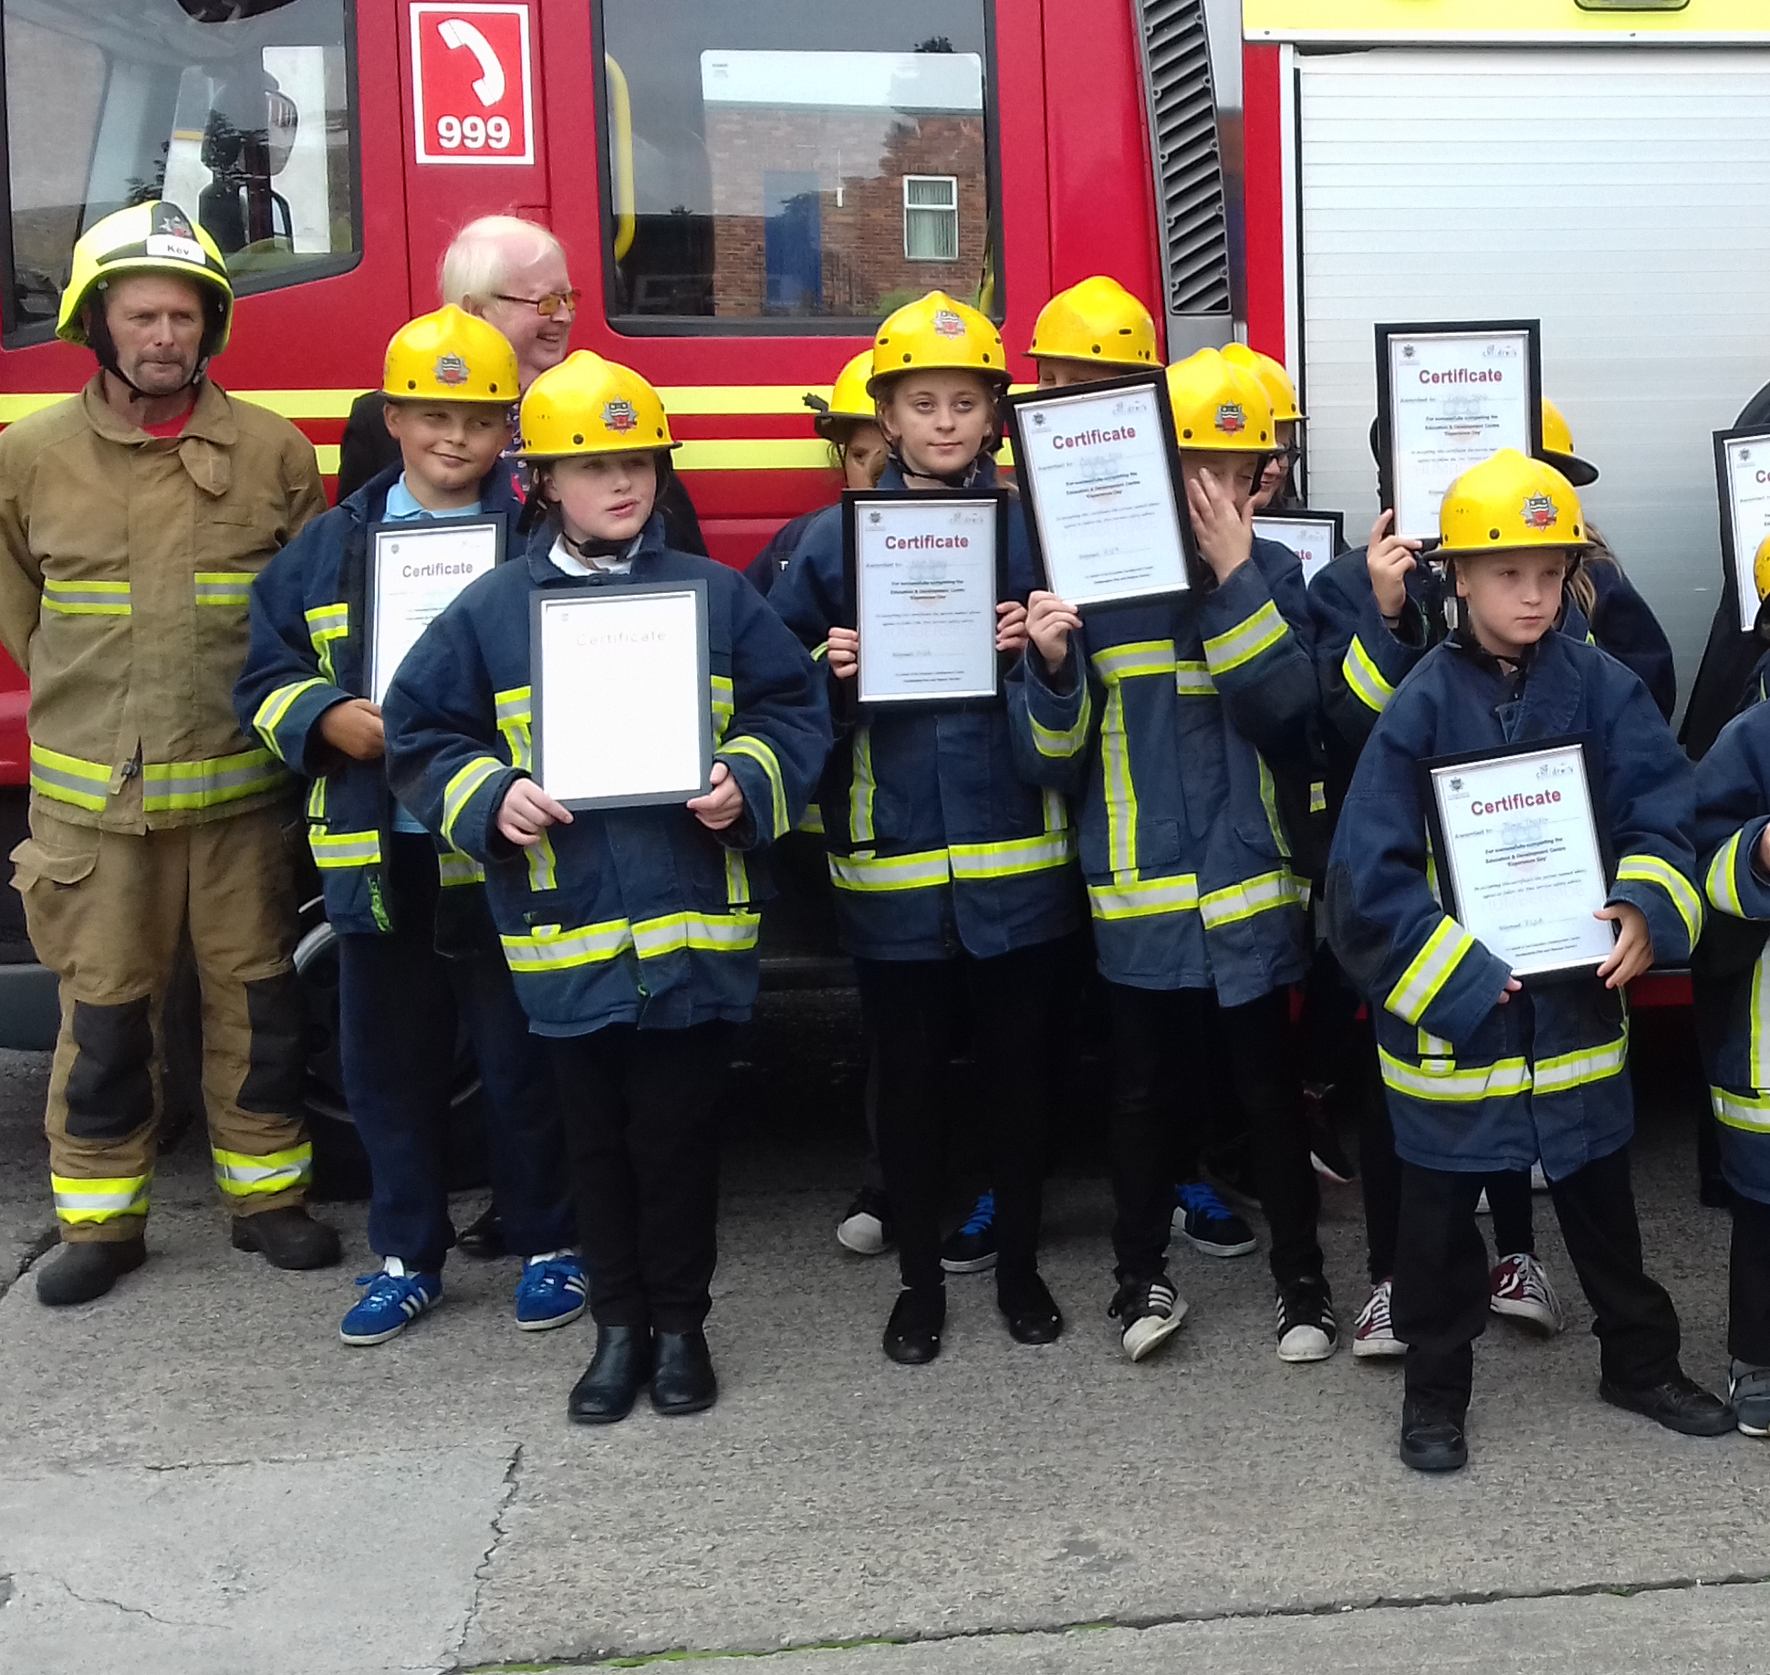
Humberside Fire & Rescue Service
Prepare, Prevent, Protect, Respond and Recover
Emergency Response
RTC
Water Rescue
Animal Rescue
Public Safety
Road Safety
Training and Education
Notes:
Humberside Fire and Rescue Service – What we do. ‘Prepare, Prevent, Protect, Respond and Recover’ We aim to make our communities safer through our work.
Water Rescue is part of our Emergency response.

Slide 3
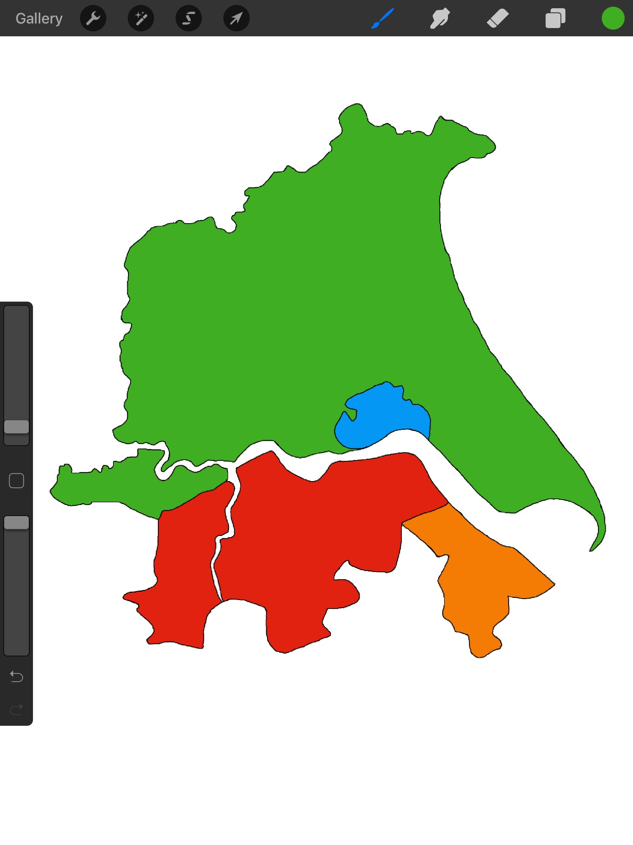
Bridlington
Service Headquarters
Full-Time Fire Station
On-C all Fire Station
Full-Time and On-Call
Training School
Admin/Standby Station
HULL
Driffield
Pocklington
EAST RIDING
Hornsea
Beverley
Market Weighton
Bransholme
Howden
Clough Road
East Hull
NORTH LINCOLNSHIRE
Withernsea
Brough
Calvert Lane
Central
We have 32 fire stations
in total:
10 - Full-Time Stations
22 - On-Call Stations
Headquarters
Preston
Snaith
Barton
Patrington
Goole
Winterton
Immingham West
Immingham East
Crowle
Brigg
Cromwell
Road
NORTH-EAST LINCOLNSHIRE
Scunthorpe
Cleethorpes
Kirton-in-Lindsey
Peaks
Lane
Epworth
Waltham
#Beourfuture
Notes:
The map to demonstrate how large the area is that we cover and that we have limited resources. Therefore, it is vital that everyone is given information and advice on how to keep themselves safe from fire etc. Explain we have large areas of water surrounding us, The River Hull, The Humber, Piers, lakes and reservoirs, and drains etc.
To be a fire fighter for Humberside, you must be 18 years old.
Full-time – A full-time firefighter works 48 hours a week and during those hour they are permanently based on the station where they go to emergency incidents and community safety jobs.
On-call – An on-call firefighter may have another full-time job. They must live within 5 minutes of the station and will be alerted to a fire call through a pager that they keep on them.

Slide 4
Advice to help you have a safe, enjoyable night and prevent injuries
Keep Safe on Bonfire Night

Slide 5
Fireworks
Fireworks can be fun, they are very pretty to look at
They are often used at celebrations to make them extra special
Notes:
Ask what is good about fireworks

Slide 6
Fireworks
They can cause injury if used incorrectly as they are explosives
They can be very unpredictable
They can be extremely loud and frighten or injure wildlife and pets
Notes:
Ask what can be bad about fireworks

Slide 7
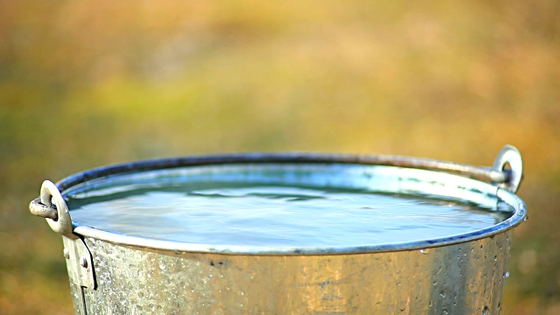
Sparklers
Don’t throw sparklers
Have a bucket of water
Sparkler safety
Notes:
Mention that sparklers burn at 5 times the heat of an actual bonfire.
Sparklers burn at a high temperature – as hot as 1000°C to 1600°C
Children under 5 years old should not be given sparklers as they can not understand just how hot they burn.
Do not throw sparklers

Slide 8
Before attending a bonfire what should you think about?
Bonfires
Make sure you stand at a safe distance from the bonfire
Do not throw anything onto the bonfire
Always make sure you are with an adult
No running

Slide 9
Pets
Keep everyone safe, including your pets
Small pets need bringing inside
Notes:
Keep animals inside on Bonfire night, they are very often frightened.
If you have a pet outside - such as a rabbit or guinea pig – ask a grown up to move them in to the house or move the hutch into a shed or garage.

Slide 10
Firework Code
Stand well back
Never go near a firework that has been lit,
even if it has not gone off, it could still explode
Never put fireworks in your pocket or throw them
Always make sure an adult is with you when you are around fireworks
Light sparklers one at a time and wear gloves
Have a bucket of water available
Notes:
Explain the fire work code.

Slide 11
Remember..
If your clothes catch fire
Notes:
Explain STOP, DROP and ROLL and that hopefully they will never need it. Ask for a volunteer to demonstrate it. Ask for the teacher to allow the children to practice in PE.

Slide 12
Not following safety advice can lead to serious consequences
Your family and the people you care about will be affected too.
Consequences
Burns
Loss of limbs
Loss of eye sight
Loss of life
Notes:
Explain that if their hands get burnt, they will have to have them bandaged up so will not be able to use your fingers and do the things they like to do e.g. play on games consoles, play on their mobile phone
Ask the students to think about the potential consequences of not following safety advice or messing around with fire.
Burns – the affect of burns can last a life time.
Talk about the pain and the ongoing treatment needed.
Talk about friends and family who will be affected too. (Seeing you in pain, having to visit the hospital, helping you carry out every day tasks)

Slide 13
Notes:
It is free to call the Emergency services from a mobile phone. You do not need to have credit.

Slide 14
For further advice and information regarding staying safe on bonfire night please visit:
www.humbersidefire.gov.uk
If you are at home or at a friends house and are worried that the fire is becoming too large or is spreading let an adult know.
Call 999 if help is needed

Slide 15
Any
questions?

